Slide 1

Calculator in Python
By: Yazeed AlKhalaf - S190280

Slide 2
Introduction
I would like to create a calculator in Python.
This calculator should be supporting Addition, Subtraction, Multiplication, and Division.
It should have good code.

Slide 3
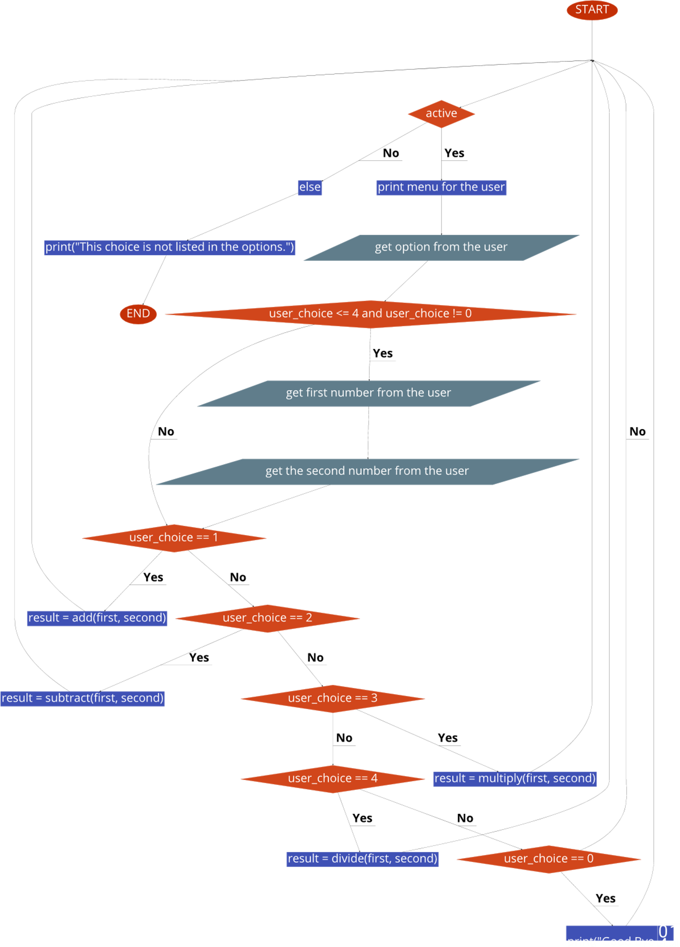
Algorithm and Flowchart
Algorithm:
Print menu.
Get option from the user.
Get first and second number from user.
Do Addition, Subtraction, Multiplication, or Division based on the user choice of option.
Print the result.
File on GitHub:
https://github.com/YazeedAlKhalaf/grade_12_ict_projects/blob/main/quarter_one_project/assets/calculator_flowchart.pdf

Slide 4
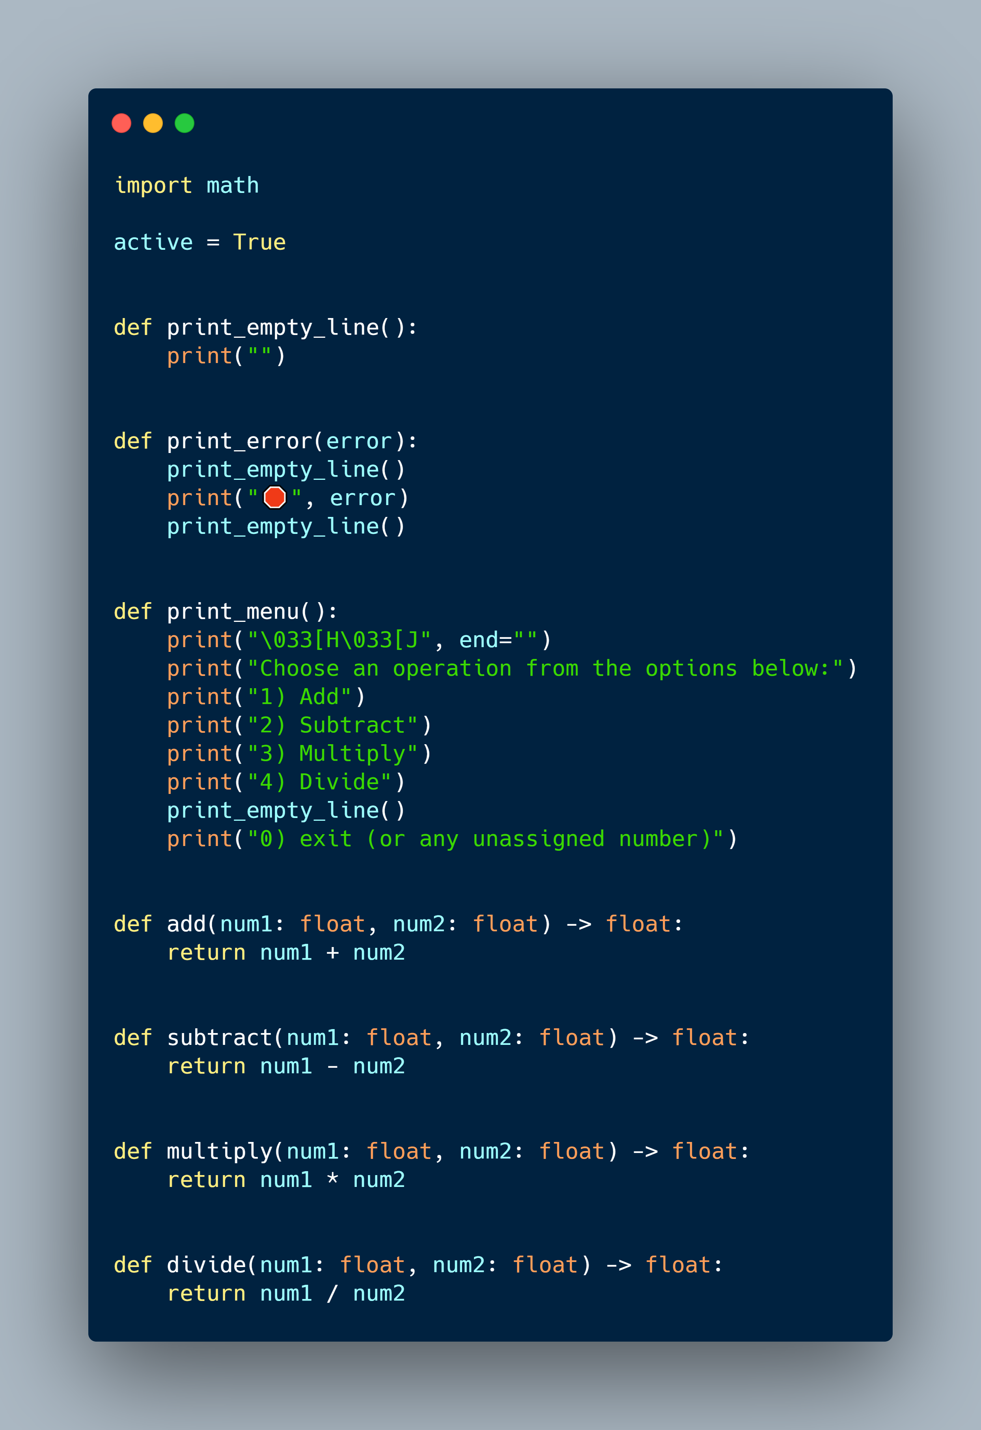
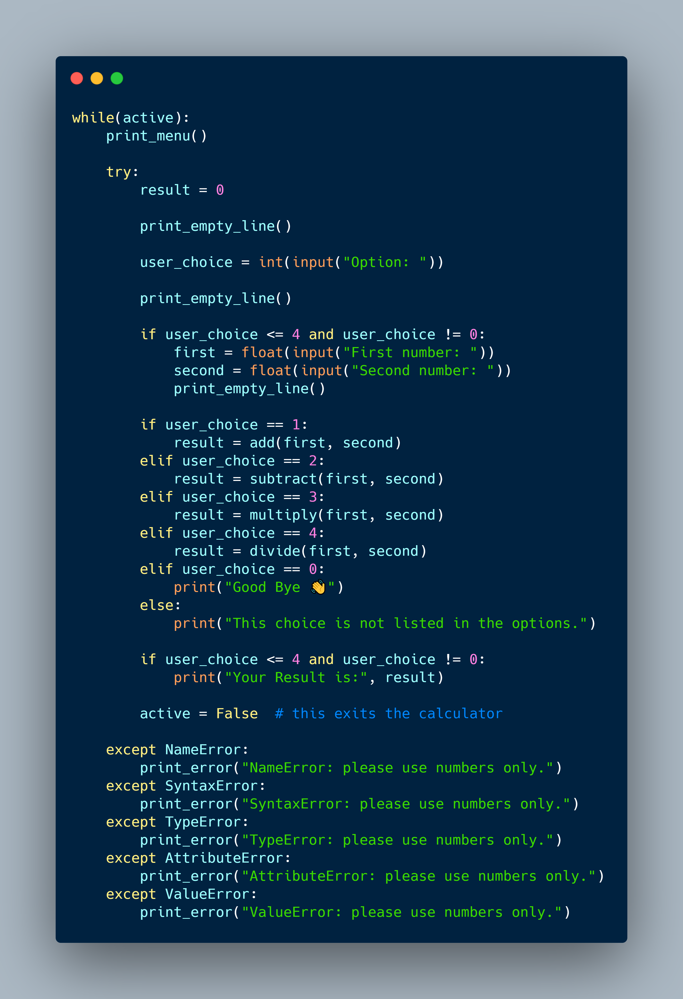
Python Program
Code on GitHub:
https://github.com/YazeedAlKhalaf/grade_12_ict_projects/tree/main/quarter_one_project

Slide 5
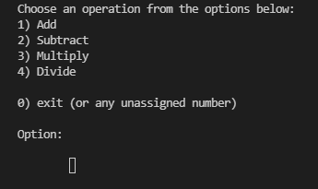
Test

Slide 6
Conclusion
I had so much fun creating this calculator. I learned so much in the Python language.
I will improve it by adding square root and squaring a number in the future.

Slide 7
Thanks
Any Questions?

